Slide 1
MBA
ORGANIZATIONAL BEHAVIOUR
UNIT 2 – WEEK 4
INDIVIDUAL BEHAVIOUR
DR. NITHYA. S
ASST PROFESSOR
UNIT 2– WEEK -4

Slide 2
Learning
Learning
  The permanent change in behaviour due to direct and indirect experience. It means change in behaviour, attitude due to education and training, practice and experience.
  It is completed by acquisition of knowledge and skills, which are relatively permanent.
Nature of Learning
  Nature of learning means the characteristic features of learning. Learning involves change; it may or may not guarantee improvement.
  It should be permanent in nature, that is learning is for lifelong.
  The change in behaviour is the result of experience, practice and training. Learning is reflected through behaviour.
  Factors Affecting Learning
  a) Motivation b) Practice c) Environment d) Mental Group

Slide 3

Types of Learners
Visual learning style
Visual learners are individuals who prefer to take in their information visually—be that with maps, graphs, diagrams, charts, and others but not with photos & videos instead need patterns. Eg: a flow chart.
Auditory learning style
Auditory learners are individuals who learn better when they take in information in auditory form when it is heard or spoken.
They are inclined to sorting their ideas after speaking, rather than thinking ideas through before.
Eg: presenting strategies that involve talking, such as lectures and group discussions or recordings of the lectures etc.

Slide 4
Types of Learners ( Contd…)
Kinesthetic learning style
Kinesthetic learners are individuals who prefer to learn by doing who enjoy a hands-on experience.
They are usually more in touch with reality and more connected to it.
The best way to present new information to them is through personal experience, or simulations.
Reading & writing
Reading & Writing Learners consume information best when it’s in words, whether that’s by writing it down or reading it.
To them, text is more powerful and these individuals usually perform very well on written assignments.
Eg: Done by describing charts and diagrams by written statements, take written quizzes on the topics, or give them written assignments.

Slide 5
Learning Process
Stimuli- Stimuli are any objects and language which draw the attention of people. Employees get stimuli from the actions of their superiors.
Attention - The degree of attention depends upon the nature of stimuli. All stimuli are not paid attention to. Technical and interesting stimuli are highly attended. Career-oriented stimuli are generally accepted by employees.
Recognition - Attention-paid stimuli are recognized as acceptable factors of improvement and new life styles. Employees paying attention to stimuli are recognizing the stimuli for learning purposes. The levels of recognition depend upon the levels of values, preferences, needs and desires of the employees.
Translation - The translation and evaluation process is a crucial point for implementing the stimuli in behaviour through reinforcement. Employees behave properly through attitude changes, objectivity, mental and physical development.
Reinforcement - Reinforced perception is learning. The perception process includes stimuli, attention, recognition, translation and behaviour. Generally positive reinforcement is more effective for making permanent changes in behaviour.

Slide 6
Learning Process ( Contd…)
Behavior -
Learning changes behaviour through reinforcement of perceived knowledge that makes permanent changes in behaviour.
Reward
Employees expect rewards for learning. If the translated behaviour provides a reward, it is accepted, otherwise it is not accepted. Employees develop their behaviour into habits.
Habits
A permanent change in behaviour becomes a habit which helps continuous improvement in behaviour and performance. Employees develop the habit of self-appraisal and development.
Motives
Motives depend on the level of satisfaction. Employees getting more satisfaction through learning develop high motives. Learning is complete only when motives are fully realized and translated into efforts.
Efforts
Habits help achieve good efforts and performance. Efforts are the automatic outcome of good habits which are acquired through the learning process. Employees willing to develop themselves are self-motivated and effort-oriented.

Slide 7
Theories of Learning
Learning can be understood clearly with the help of some theories that will explain our behavior.
Learning Theories:
  Classical Conditioning Theory
  Operant Conditioning Theory
  Social Learning Theory
  Cognitive Learning Theory

Slide 8
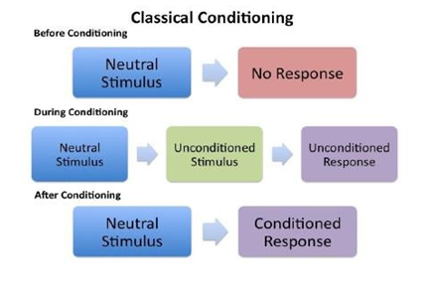
Theories of Learning (Contd…)
Classical Conditioning Theory
occurs when a conditioned stimulus is coupled with an unconditioned stimulus.

Slide 9
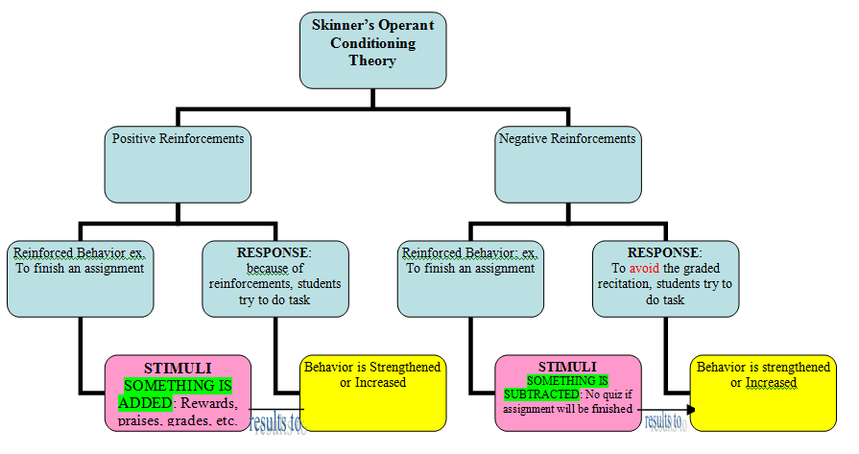
Theories of Learning ( Contd…)
Operant Conditioning Theory
Otherwise known as instrumental conditioning - a learning process in which behavior is sensitive to, or controlled by its outcomes.
Eg: A child may learn to open a box to get the candy inside, or learn to avoid touching a hot stove.

Slide 10
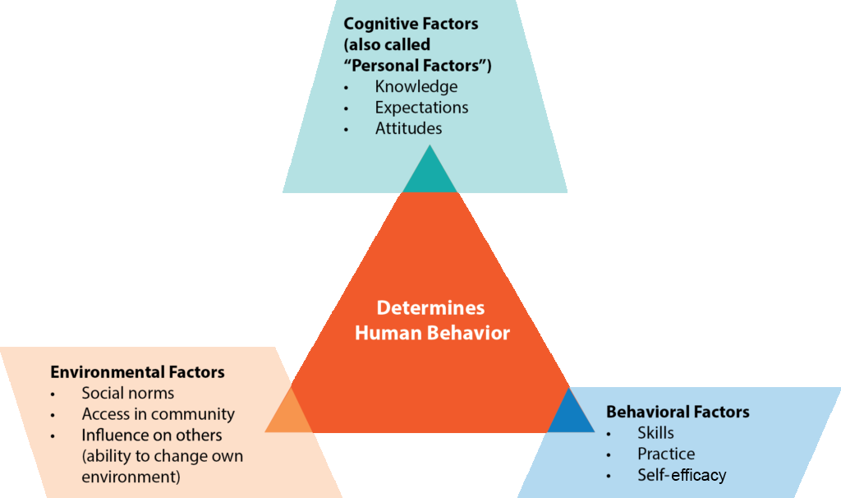
Theories of Learning ( Contd…)
Social Learning Theory
The key assumptions of social learning theory are as follows −
  Learning is not exactly behavioural, instead it is a cognitive process that takes place in a social context.
  occurs by observing a behaviour and the outcomes of the behaviour (known as vicarious reinforcement).
  Learning includes observation, extraction of information from those observations, and making decisions regarding the performance of the behaviour (known as observational learning or modelling).
  The learner is not a passive receiver of information. Understanding, environment, and behaviour all mutually influence each other.

Slide 11
Theories of Learning ( Contd…)
Cognitive Learning Theory
Cognition defines a person‘s ideas, thoughts, knowledge, interpretation, understanding about himself and environment.
This theory considers learning as the outcome of deliberate thinking on a problem or situation based upon known facts and responding in an objective and more oriented manner.
It perceives that a person learns the meaning of various objects and events and also learns the response depending upon the meaning assigned to the stimuli.

Slide 12
Emotions
Emotions in simple are defined as movement.
Emotion is considered as the energy that motivates an individual to do actions.
It has been taught earlier that energy can neither be created nor destroyed, rather it only flows being a primary source of influence and power and that’s the reason for it to be called as e-motion.
People’s responses to their feelings when they are happy will be light, floating, flying, flowing and when they are sad will be heavy, bogged down, unable to move, be paralyzed.
Individual’s intensities may vary but universally their feelings are same and this can be extended to with even people with varying cultures across all parts of the world.
Hence, emotion is the energy level that varies in each individual according to his/her different emotional states at different situations.

Slide 13
Emotional labor
Emotional Labor is the process of managing feelings and expressions to fulfill the emotional requirements of a job.
More specifically, workers are expected to regulate their emotions during interactions with customers, co-workers, clients and managers.
Therefore, Emotional labor is a work-specific role. It involves managing emotions during interactions (e.g., organizational outsiders) to achieve professional goals and confirm to work role requirements.
As a form of labor, emotional labor is most prototypically in jobs that require “service with a smile”, or any front-line, public-facing job interacting with clients, customers, and patients.

Slide 14
Types of Emotional Labor
Surface Acting - pretending or regulating one's emotional expressions
In surface acting, “people are showing, or trying to show, a different emotion than the ones that they are truly experiencing,” explains Dr. Badali.
“In a workplace for example, a worker who is surface acting may be smiling as they sell product to customers while inside feeling angry toward their coworker.
Deep acting - consciously modifying one's emotions to express a desired emotion (Grandey, 2000; Hochschild, 1983).
Workers try to regulate their feelings—not just their emotional display—by trying to change their thought patterns.
Workers in deep acting will try to make their true emotions in line with the emotions expected of them on the job.
“In a workplace for an example, a worker who is deep acting may try to shift their emotions from anger by focusing on their role as someone who can be part of providing a once-in-a-lifetime experience to a family,” says Dr. Badali.

Slide 15
Emotional Intelligence
Emotional intelligence (EI) when measured quantitatively - termed Emotional quotient (EQ).
Emotional intelligence is the ability to understand one’s own and other’s feelings and emotions that helps one to discriminate the various blends of emotions aroused on them and, to use this information to guide, regulate and finely tune one’s thinking and action according to situations.
Daniel Goleman (1998): Emotional intelligence is the capacity for recognizing our own feelings and those of others, for motivating ourselves, and for managing emotions well in us and in our relationships.
Dalip Singh (2003): Emotional intelligence is the ability of an individual to appropriately and successfully respond to vast variety of emotional stimuli being elicited from the inner self and immediate environment.
dynamics of human behavior.

Slide 16
THEORIES/ MODELS OF EMOTIONAL INTELLIGENCE
      a) Ability Model
      b) Mixed Models
      c) Trait EI Model
      d) Bar-On model of Emotional-Social Intelligence
a) ABILITY MODEL: Peter Salovey and John D. Mayer’s -1990
Emotional intelligence - “the ability to perceive emotions, integrate emotions to facilitate thought, understand emotions and to regulate emotions to promote personal growth.
The ability based model sights emotions as useful sources of information that help one to make sense of and navigate the social environment.
The model proposes that individuals vary in their ability to relate emotional processing to a wider cognition and this ability is seen to manifest itself in certain adaptive behaviors.

Slide 17
THEORIES/ MODELS OF EMOTIONAL INTELLIGENCE ( Contd…)
b) MIXED MODELS OF EI
The Emotional Competencies Model: Dr. Daniel Goleman
EI as a wide array of competencies and skills that drive managerial performance, is measured by multi-rater assessment and self-assessment via the Emotional Competency Inventory and the Emotional and Social Competency Inventory.
Goleman’s model includes four main Emotional intelligence constructs namely Self-awareness, Self-management, Social awareness and Relationship management.
Each of these variables includes a set of Emotional competencies which are not innate talents, but rather learned capabilities that may be worked on and developed to achieve outstanding performance.

Slide 18
THEORIES/ MODELS OF EMOTIONAL INTELLIGENCE ( Contd…)
3) TRAIT EI MODEL - Petrides et al (2000, 2003, and 2006)
Refers to “a constellation of behavioral dispositions and self-perceptions that concerns one’s ability to recognize, process, and utilize emotion-laden information”.
This encompasses behavioral dispositions and self perceived abilities which are measured by self report, as opposed to the ability based model which refer to actual abilities as they express themselves in performance based measures.
4) Bar-On model of Emotional-Social Intelligence (ESI): Reuven Bar-On (2006)
Defines Emotional intelligence as being concerned with effectively understanding oneself and others, relating well to people, and adapting to and coping with the immediate surroundings to be more successful in dealing with environmental demands.
In general, Bar-On considers Emotional intelligence and Cognitive intelligence to contribute equally to a person’s general intelligence, which then offers an indication of one’s potentiality to succeed in life.

Slide 19


